Slide 1
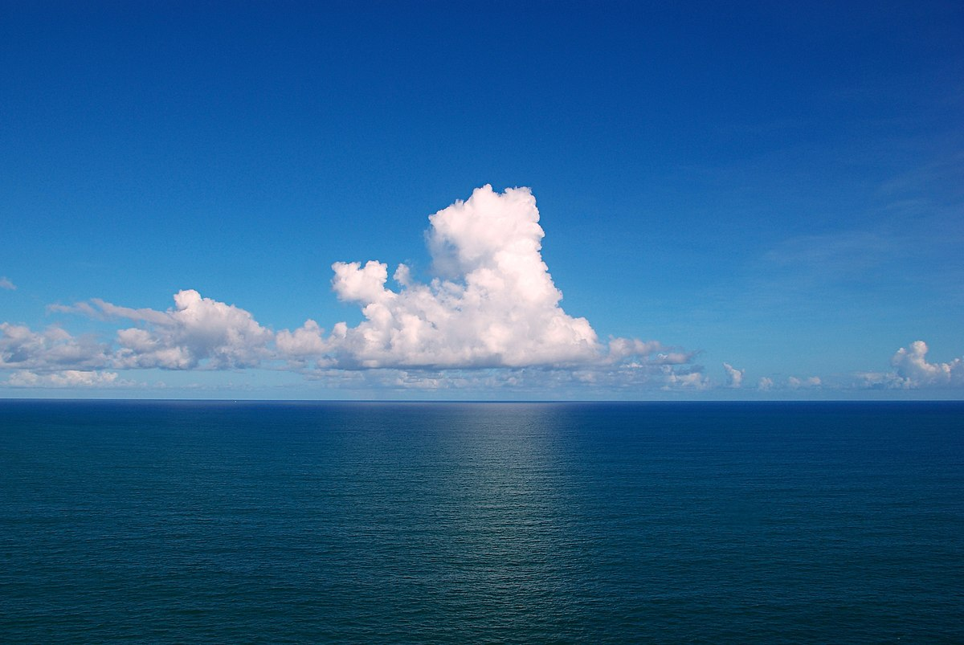

Ocean - atmosphere coupling at the
oceanic mesoscale
The impact of SST structures on surface fluxes
and the air column in a coupled simulation
Presenter: Alessandro Storer
Supervision: prof. Claudia Pasquero
prof. Dino Zardi (Univ. Trento)
Meteo X Change conference, 10 – 11 April 2025

Slide 2
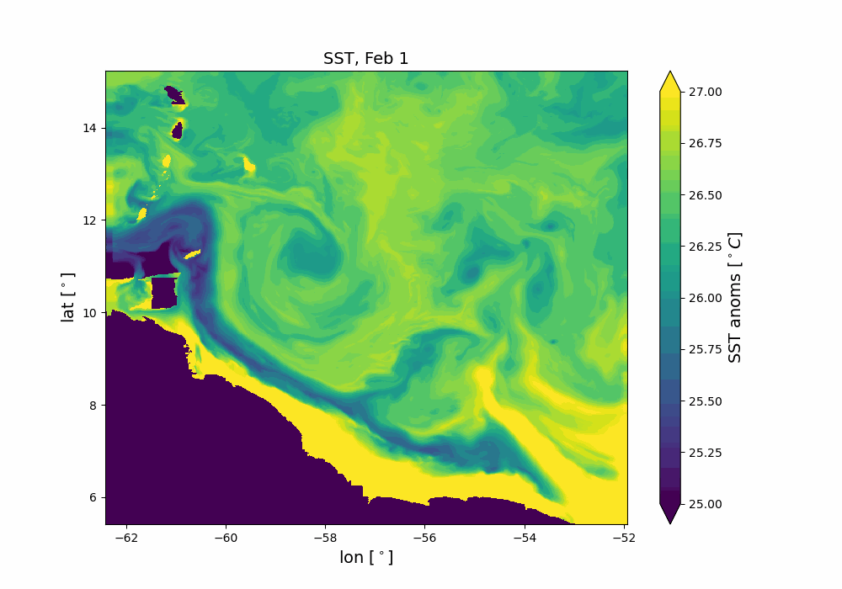
The Mesoscale – an introduction
Scales ~ 100 km
Features like:
Temperature fronts
Eddies
Important in the global energy budget!
(Renault 2023, Seo 2023, Bishop 2020)
Thermal feedback TFB
Modulates local temperature, stability and circulation through modified thermodynamic fluxes

Slide 3

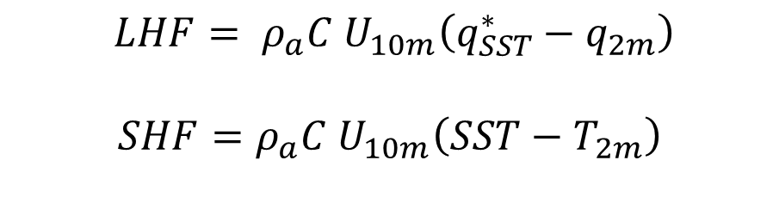
Sensitivity of surface enthalpy fluxes to SST
$$LHF= ρ_{a}C U_{10m}\left(q_{SST}^{∗}−q_{2m}\right)$$
$$SHF=ρ_{a}C U_{10m}\left(SST−T_{2m}\right)$$
Inderisci schema colorato qui
$$sensitivities == \frac{∂LHF}{∂SST}$$

Slide 4
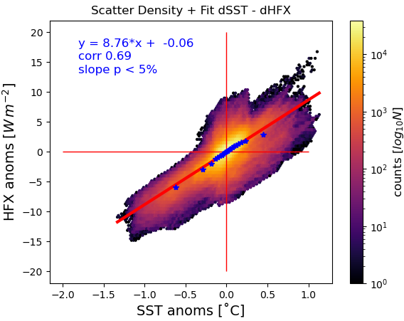
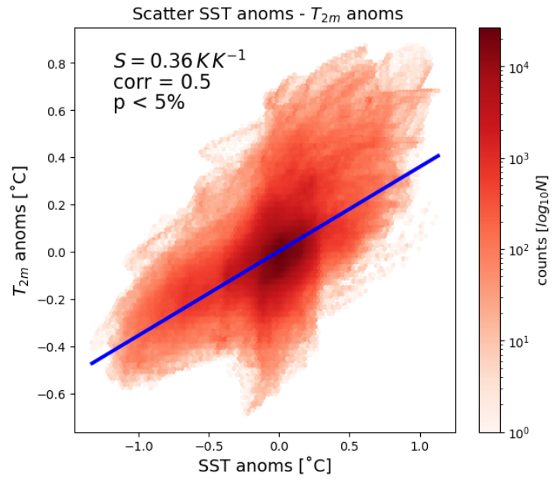

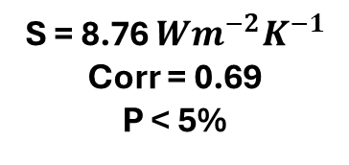
SENSIBLE HEAT FLUX
SHF anomalies
$T_{2m}$ anomalies
dSHF
S = 8.76 $Wm^{−2}K^{−1}$
Corr = 0.69
P < 5%
SHF

Slide 5
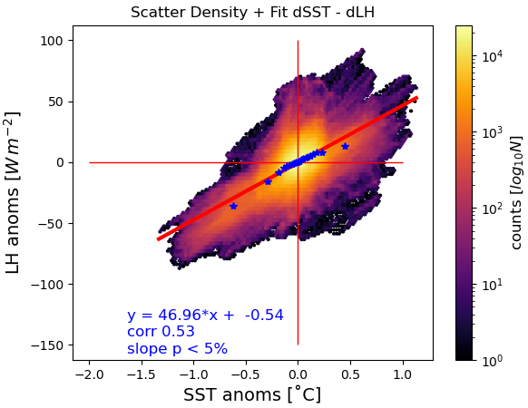
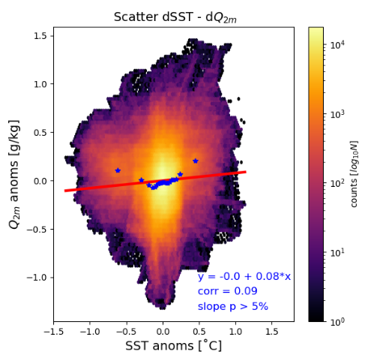
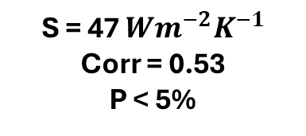
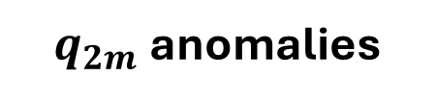
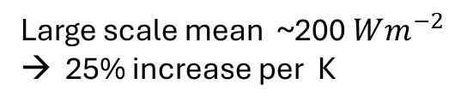
LATENT HEAT FLUX
LHF anomalies
$q_{2m}$anomalies
S = 47 $Wm^{−2}K^{−1}$
Corr = 0.53
P < 5%
Large scale mean ~$\text{200} Wm^{−2}$
→ 25% increase per K

Slide 7
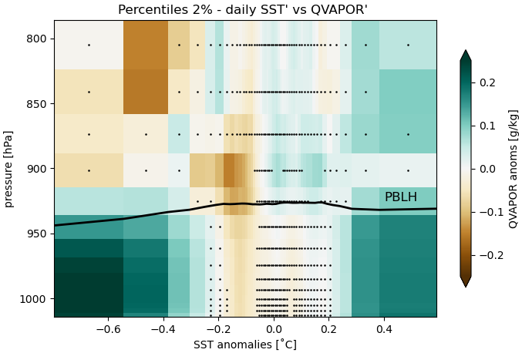
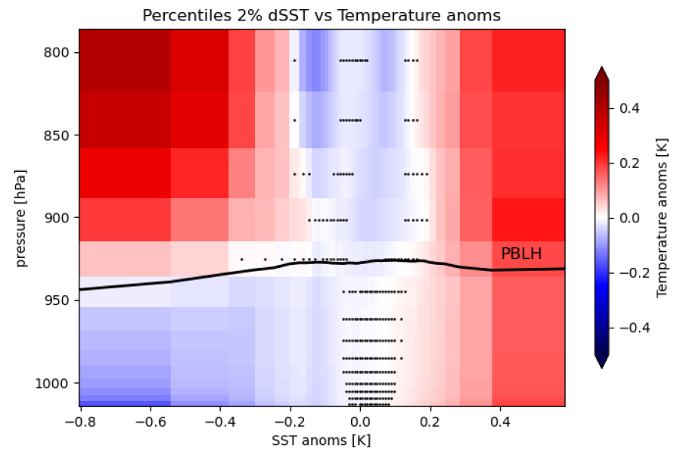
Moisture budget and relative humidity
Water vapour anomalies
Temperature anomalies
WVMR’

Slide 20


STUDYING THE MESOSCALE COUPLING BETWEEN ATMOSPHERE AND OCEAN IN A HIGH-RESOLUTION SIMULATION: HOW ARE THE MARINE BOUNDARY LAYER AND HEAT FLUXES IMPACTED BY THE SST ANOMALIES?
Master of Science in Environmental Meteorology
29th October 2024
Candidate: STORER Alessandro
Matriculation: 240734
Advising Supervisor: PASQUERO Claudia
Internal Supervisor: ZARDI Dino
Hosting institution: University of Milan-Bicocca

Slide 21
Radiative budget
T , q air
wind
SST, q source
Turbulent fluxes
LHF, SHF
currents
Notes:
the coupling between marine shallow
trade-wind clouds and circulation is known to play a cen-
tral role in the uncertainty of the tropical cloud feedback and climate sensitivity estimated by models

Slide 22
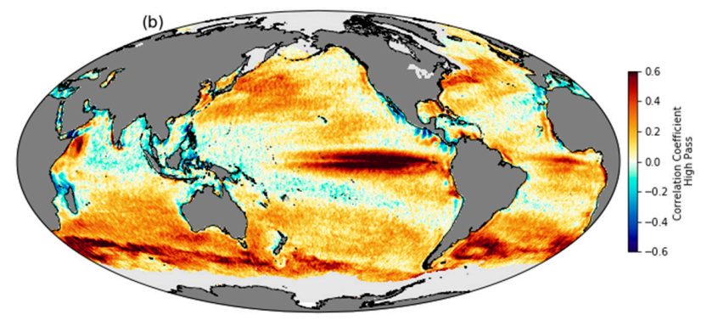
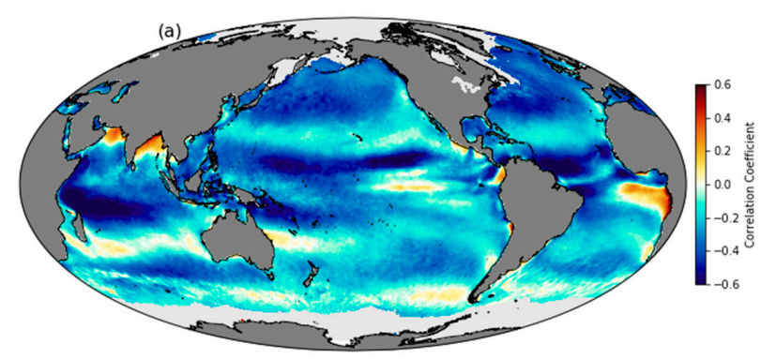
INTRODUCING THE LOCAL SCALE
Correlation between QuikScat wind speed and NOAA Optimum Interpolated SST using daily, 25-km-gridded data from 2000–2009.
Same, but for 1000km high-pass filtered data: notice the thorough change of correlation signs.
Gentemann et al. 2020

Slide 23
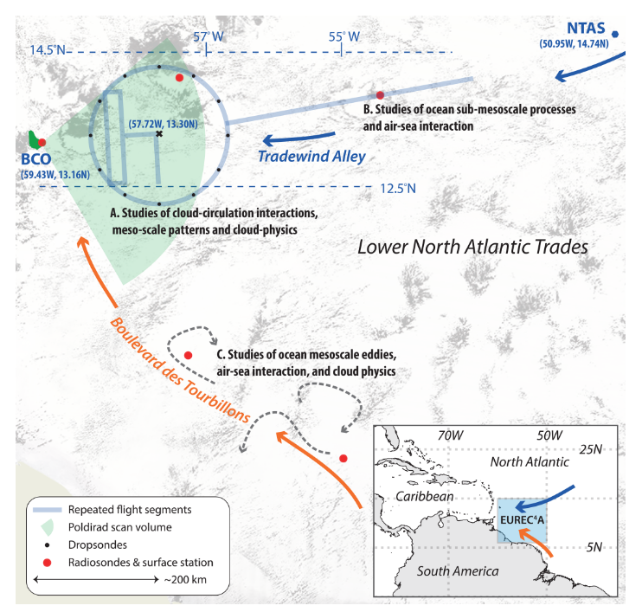
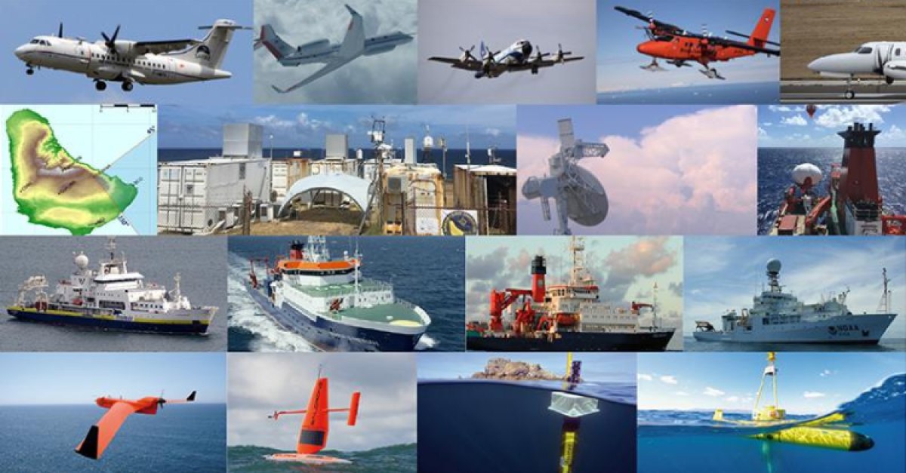
The EUREC4A - ATOMIC campaign Stevens et al 2021
Investigate small scale air-sea coupling and cloud-convection feedbacks
Notes:
ElUcidating the RolE of Cloud–Circulation Coupling in ClimAte - Atlantic Tradewind Ocean–Atmosphere Mesoscale Interaction

Slide 24
CORE QUESTION
what is the impact of mesoscale SST variability
on the atmospheric fields and surface fluxes?
HOW?
STATISTICAL ANALYSES ON DAILY AVERAGES
Response of air column
Sensitivity of HFs to SST
Analysis of LHF spatial variance
Simulation characteristics:
Ocean: CROCO, 1km, 4yr spin-up
Atmosphere: WRF v4.2 , 2km, 1-month spin up:
Nested into a larger domain, forced with hourly ERA5 outputs, downscaled onto a 6km intermediate buffer grid
COUPLING:
OASIS3-MCT coupler
WRF → CROCO: hourly means of momentum and heat fluxes
CROCO → WRF: SST-related heat fluxes and stress modifications by surface currents
Details in Conejero et al. 2024

Slide 25
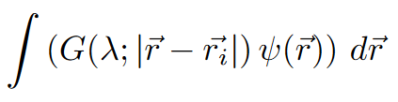
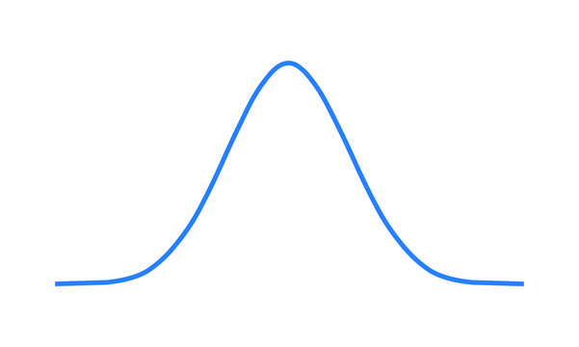
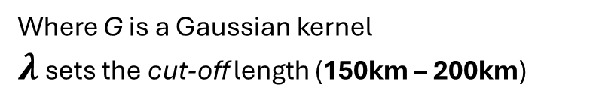
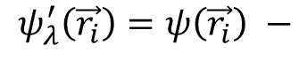
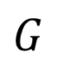
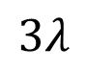
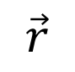
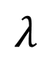
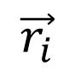
METHODS - a first glimpse
Anomalies == high-pass filtered data
$$ψ_{λ}^{′}\left(\vec{r_{i}}\right)=ψ\left(\vec{r_{i}}\right) −$$
Where G is a Gaussian kernel
$λ$ sets the cut-off length (150km – 200km)
$$G$$
$$λ$$
STATISTICAL SIGNIFICANCE: subsampling according to autorrelation lengthscales
$$\vec{r_{i}}$$
$$\vec{r}$$
$$3λ$$

Slide 26
METHODS - a first glimpse
Anomalies == high-pass filtered data
$$ψ_{λ}^{′}\left(\vec{r_{i}}\right)=ψ\left(\vec{r_{i}}\right) −$$
Where G is a Gaussian kernel
$λ$ sets the cut-off length (150km – 200km)
$$G$$
$$λ$$
STATISTICAL SIGNIFICANCE: subsampling according to autorrelation lengthscales
$$\vec{r_{i}}$$
$$\vec{r}$$
$$3λ$$

Slide 27
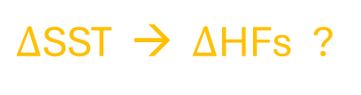
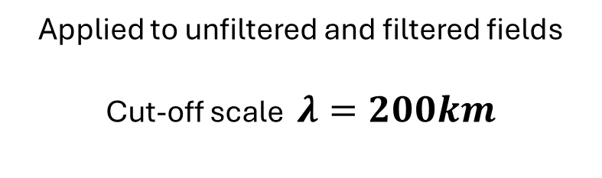
Sensitivity of surface thermodynamic fluxes to SST
HOW?
Linear regressions against SST
SST’ > 0
SST’ < 0
$Δ$SST → $Δ$HFs ?
Applied to unfiltered and filtered fields
Cut-off scale $λ=200km$

Slide 28
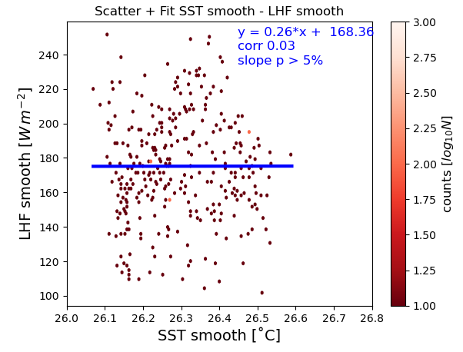


$$\frac{∂LHF}{∂SST}=\frac{∂ ρ_{a}C U_{10m}(q_{SST}^{∗}−q_{2m})}{∂SST}$$
Low – pass
High – pass
Corr = 0.03
P > 5%
S = 47 $Wm^{−2}K^{−1}$
Corr = 0.53
P < 5%
LHF ANOMALIES STRONGLY DEPEND ON SMALL SCALE SST PATTERNS!

Slide 29
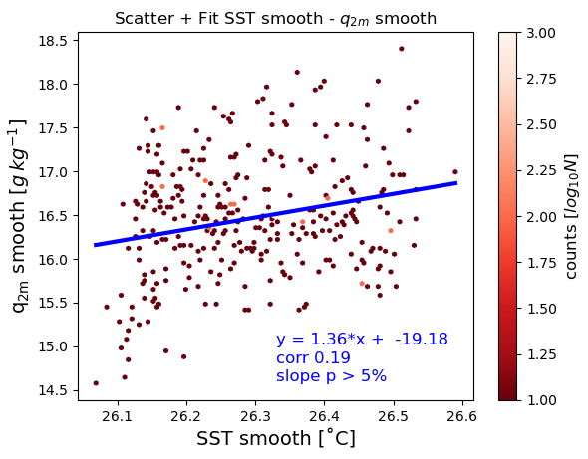
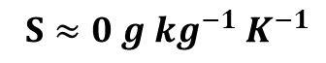
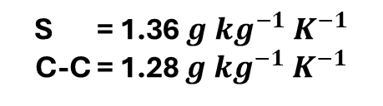
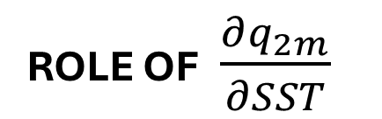
ROLE OF $\frac{∂q_{2m}}{∂SST}$
Low – pass
High – pass
$S≈0 {g kg^{−1} K}^{−1}$
S = 1.36 ${g kg^{−1} K}^{−1}$
C-C = 1.28 ${g kg^{−1} K}^{−1}$
MAIN CONCLUSION: $q_{2m}$IS INDEPENDENT OF SST ANOMALIES!
Notes:
The large scale – only sensitivity of 2m moisture instead follows CC

Slide 30

SENSIBLE HEAT FLUX
$\frac{∂HFX′}{∂SST′}$ $\frac{∂T_{2m}′}{∂SST′}$
dSHF
S = 8.76 $Wm^{−2}K^{−1}$
Corr = 0.69
P < 5%
SHF
MESOSCALE $T_{2M}$ DOES NOT ADJUST TO SST !

Slide 31
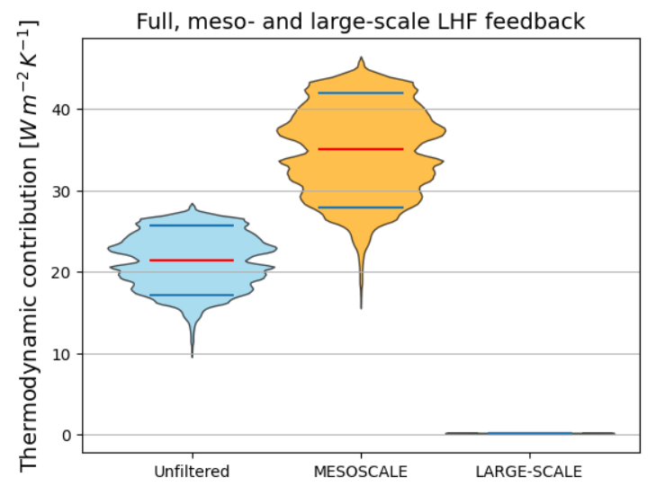
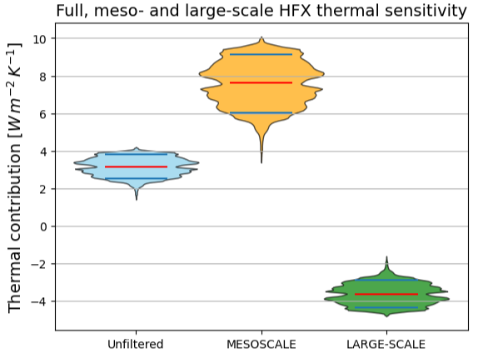
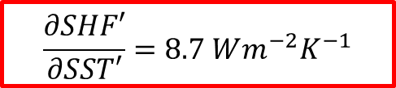



HOW DO THERMODYNAMIC SENSITIVITIES
CONTRIBUTE TO HFs TOTAL COUPLING?
$$ρ_{a}C U_{10m}\frac{ ∂(q_{SST}^{∗}−q_{2m})}{∂SST}$$
$$ρ_{a}C U_{10m}\frac{∂\left(SST −T_{2m}\right)}{∂SST}$$
$$\frac{∂LHF′}{∂SST′}=47 Wm^{−2}K^{−1}$$
$$\frac{∂SHF′}{∂SST′}=8.7 Wm^{−2}K^{−1}$$
Recall …

Slide 32
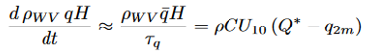
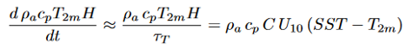
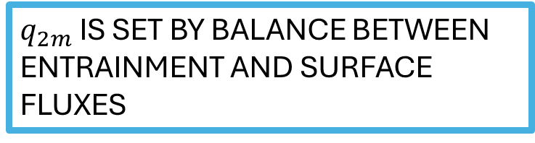
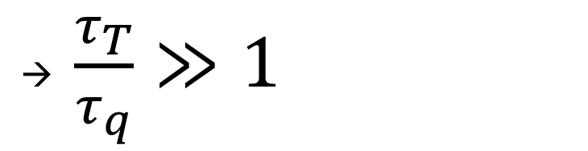
Ideal MABL:
Vertically homogeneous
NO horizontal advection
ONLY surface fluxes
Newtonian relaxation
MABL
LHF, SHF
→ $\frac{τ_{T}}{τ_{q}}≫1$
MABL would saturate faster than it would heat up
$q_{2m}$ IS SET BY BALANCE BETWEEN ENTRAINMENT AND SURFACE FLUXES

Slide 33
Response of the air column following SST anomalies
HOW?
Percentile bins
MABL
Split data into 5% or 2% bins for every vertical level and take mean of every bin
Pressure – SST cross sections
SST’ > 0
SST’ < 0
Borgnino et al. 2024 , under revision

Slide 34
Moisture budget and relative humidity
Water vapour anomalies
Temperature anomalies
WVMR’
SST anomalies constrain only SATURATION, not WVMR

Slide 35
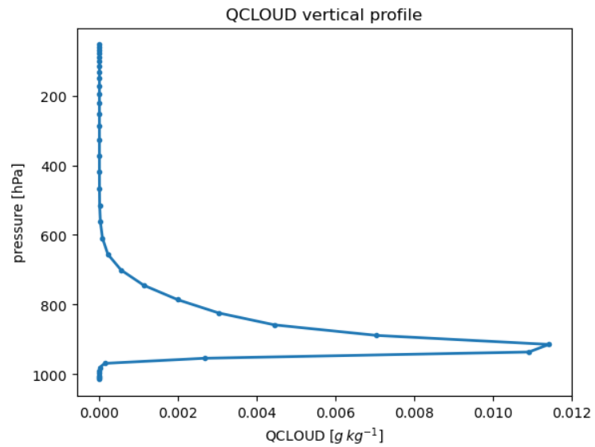
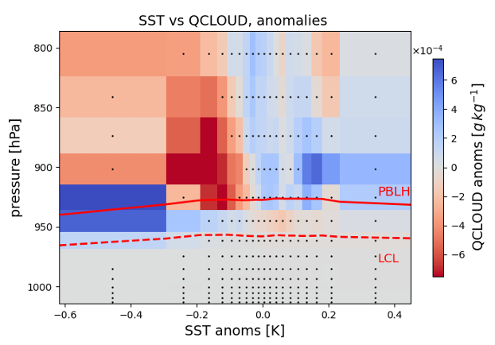
Liquid cloud water content mixing ratio
COLD anomalies: lower cloud base, closer to LCL
WARM anomalies: higher cloud base, more mixing between LCL and MABL top
NET EXPORT OF MOISTURE AND CLOUD WATER FROM PBL

Slide 36
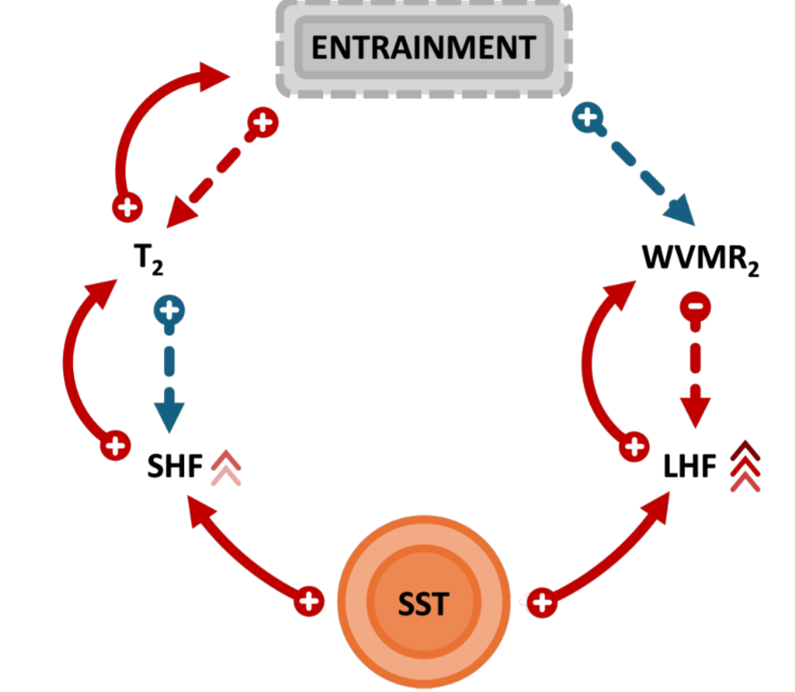
Enhanced entrainment WARMS and DRIES the MABL
Entrainment feedbacks
On surface fluxes
SST modifies fluxes
Borgnino et al. 2024

Slide 37
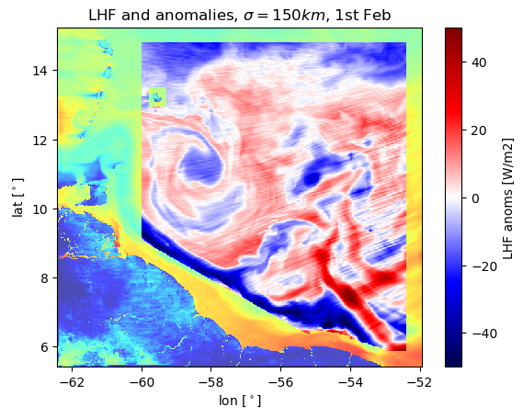
Is SST actually the dominant factor driving LHF?
HOW?
Local covariances
with Gaussian kernel

Slide 38
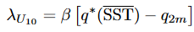
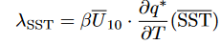
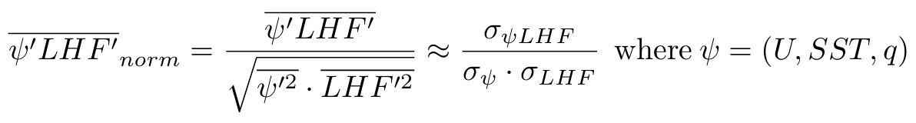

Decompose LHF in a large and a small-scale component
OVERBAR = low-pass filter, $λ=150km$
From here, define the local correlation metric

Slide 39
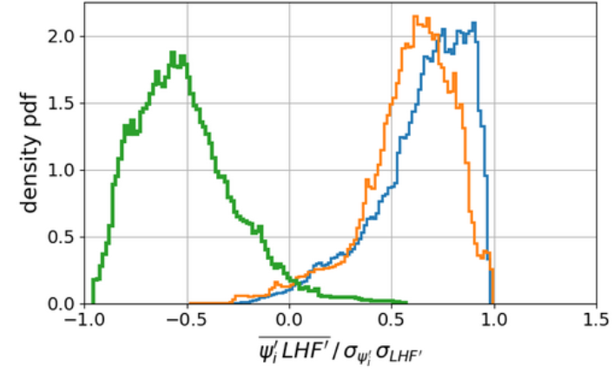
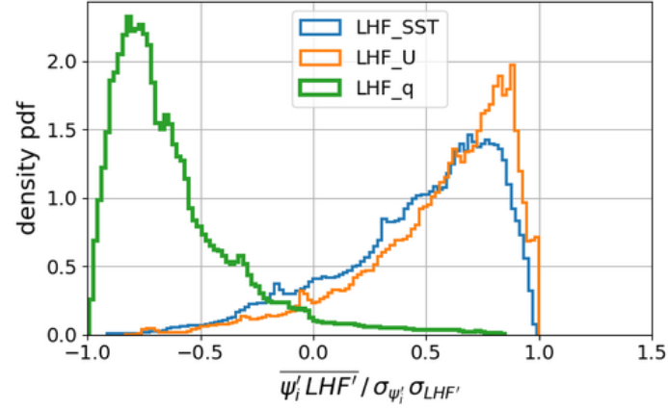
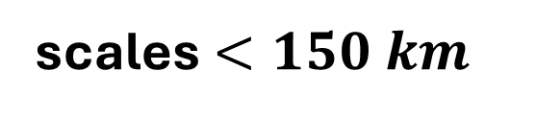


NORMALIZED COVARIANCES («LOCAL CORRELATIONS»)
scales $<150 km$
$$60km<scales <150km$$
$$ψ_{i}=\left(SST, U, q\right)$$
SST variability dominates at small scales
U leads variability at larger scales
q is important in inhibiting LHF release

Slide 40

In the end …
We studied the influence of mesoscale SST patterns on atmospheric variables
SST anomalies DO modify surface fluxes
SST anomalies DO impact static stability and thus MABL turbulence
SST anomalies DO NOT constrain MABL moisture, but T and clouds
SSTs dominate the spatial variability of LHF
FUTURE RESEARCH
- How can we quantify entrainment?
How do coupling feedbacks actually shape SST?
SMOCs ?

Slide 41
Supplementary Material
LOCAL VARIANCES
LOCAL COVARIANCES

Slide 42

The Gulf Stream case
OPERATIONAL DEFINITION OF OCEANIC MESOSCALE
Notes:
The literature on GS is immense, I really cannot dedicate much time on it: just know that it is so energetic

Slide 43

Credits: Allison Wing

Slide 44


TWO MAIN MABL RESPONSE MECHANISMS
Pressure Adjustment (PA)
Downward Momentum mixing (DMM)
$∇⋅\vec{u}=α_{PA}∇^{2}SST$
$∂_{r}u_{r}=α_{DM} ∂_{r}SST$
weak wind, neutral column
strong wind, unstable air
Secondary circulation
THERMODYNAMIC FEEDBACKS
strong wind and
neutral stability conditions
Altitude
Mean profile
Wind speed
Pasquero et al. 2021, Desbiolles et al. 2023
Notes:
conditions relative to SST structure scale

Slide 45

Getting to know the simulation …
Observations from R/V MS Merian in Boulevard des Tourbillons

Slide 46


No wind variability in lower troposphere
Rare deep convection and limited rain
Notes:
Std pressure: 3h
Frequency of cloud liquid water over 600hPa is less than 5% over the whole month

Slide 47
Supplementary material: Air column response

Slide 48


Mean vertical profiles

Slide 49




Brunt – Vaisala frequency (BV - $N^{2}$)
Notes:
Scale is common
subsiding air in the trade winds regio

Slide 50

Figure 8 from Acquistapace et al., 2022: Height-sea surface temperature (SST) section of the rain-free
diurnal anomalies of [...] (b) latent heat flux (LHF) estimated from Atmospheric Raman Temperature and Humidity. Sounder and Doppler lidars observations.
The measured MABL height settled at around 500m over colder SSTs and 750m over warmer ones

Slide 51


Wind speed and horizontal convergence

Slide 52


Variability of vertical wind speed

Slide 53


Boundary layer height (PBLH)

Slide 54


Lifting Condensation Level (LCL)

Slide 55


Relating PBLH and LCL

Slide 56




HOW DO THERMODYNAMIC SENSITIVITIES
CONTRIBUTE TO HFs TOTAL COUPLING?
$$ρ_{a}C U_{10m}\frac{ ∂(q_{SST}^{∗}−q_{2m})}{∂SST}$$
$$ρ_{a}C U_{10m}\frac{∂\left(SST −T_{2m}\right)}{∂SST}$$

Slide 57
Supplementary material:
variance analysis

Slide 58

Visualizing the band-pass filter…

Slide 59

What is the role of coupling in shaping SST ?

Slide 60




SST-LHF local covariances

Slide 61




U-LHF local covariances

Slide 62




Q-LHF local covariances

Slide 63






Decompose LHF in a large and a small-scale component
SST TERMS
NON-SST TERMS

Slide 64


HOW IS THE TOTAL $\overline{LHF^{′2}}$ RECONSTRUCTED?
density pdf
SST-related explain much when small scales are included
NON-SST-related explain more when small scales are neglected
HP : high-pass
BP : band-pass
60km
150km

Slide 65


Slide 66
Humidity
Radiative balance
Convective
organization
wind
SST
Turbulent fluxes
LHF, HFX
currents
Notes:
the coupling between marine shallow
trade-wind clouds and circulation is known to play a cen-
tral role in the uncertainty of the tropical cloud feedback and climate sensitivity estimated by models

Slide 67

Be honest : How often do you think about oceans?

Slide 68


Not only MABL
GS is forcing the entire troposphere!
Minobe et al. 2010
Notes:
« to a surface convergence field, there corresponds a reaction by the whole troposphere

Slide 69

Reconstructed surface currents on 4th February 2020: peaks (yellow shadings) correspond to approx. 1m/s
Source: https://earth.nullschool.net/
Red box: the EUREC4A region
and computational domain

